Slide 1
Nonparametric Tests
CHAPTER 10

Slide 2
Learning Objectives (1 of 2)
Compare and contrast parametric and nonparametric tests
Identify multiple applications where nonparametric approaches are appropriate
Perform and interpret the Mann–Whitney U test
Perform and interpret the Sign test and Wilcoxon Signed Rank test

Slide 3
Learning Objectives (2 of 2)
Compare and contrast the Sign test and Wilcoxon Signed Rank test
Perform and interpret the Kruskal–Wallis test
Identify the appropriate nonparametric hypothesis testing procedure based on type of outcome variable and number of samples

Slide 4
Nonparametric Tests
Appropriate when outcome is continuous but not normally distributed
Rank scores (e.g., disease stage)
Continuous but subject to extremes
Continuous but there are limits of detection (on high or low end of scale)

Slide 5
General Approach
Rank data
Perform analysis on ranks
Follow same 5-step procedure for hypothesis testing

Slide 6
Ranking Data
Raw data
7 5 9 3 0 2
Ordered data
0 2 3 5 7 9
Ranked data
1 2 3 4 5 6

Slide 7
Ranking Data with Ties
Raw data
7 7 9 3 0 2
Ordered data
0 2 3 7 7 9
Ranked data
1 2 3 4.5 4.5 6
Assign mean rank to ties,
Sum of ranks = n(n + 1)/2

Slide 8
Tests with Two Independent Samples: Mann–Whitney U Test (1 of 2)
Continuous outcome that is not assumed to follow a normal distribution
Two independent samples
H₀: Two populations are equal
H₁: Two populations are not equal

Slide 9
Tests with Two Independent Samples: Mann–Whitney U Test (2 of 2)
Test statistic is U = min(U₁, U₂),
where R₁ and R₂ are the sums of the ranks in groups 1 and 2.
Reject H₀ if U ≤ critical value in Table 5.

Slide 10
Example 10.1. Mann–Whitney U Test (1 of 4)
A Phase II clinical trial is run to investigate efficacy of a new drug for asthma in children.
Outcome is number of episodes of shortness of breath over a 1-week period.
Placebo 7 5 6 4 12
Drug 3 6 4 2 1

Slide 11
Example 10.1. Mann–Whitney U Test (2 of 4)
H₀: The two populations are equal
H₁: The two populations are not equal
α = 0.05
Test statistic is U.
Rank data in pooled sample (n = 10), and compute R₁ and R₂.

Slide 12
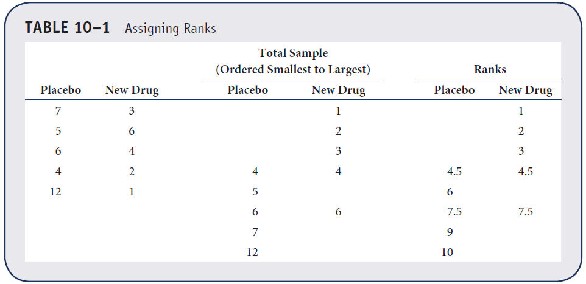
Example 10.1. Mann–Whitney U Test (3 of 4)

Slide 13
Example 10.1. Mann–Whitney U Test (4 of 4)
Test statistic is U = 3.
Reject H0 if U ≤ 2 (Table 5).
Do not reject H0 because 3 > 2. We do not have significant evidence to show that the two populations are not equal.

Slide 14
Tests with Matched Samples: Sign Test (1 of 2)
Continuous outcome measured in matched or paired samples; differences are not assumed to follow a normal distribution.
Matched or paired samples
H₀: Median difference is zero
H₁: Median difference >, <, or ≠ 0

Slide 15
Tests with Matched Samples: Sign Test (2 of 2)
Test statistic is the smaller of the number of positive or negative signs (of differences).
Reject H₀ if the smaller of the number of positive of negative signs ≤ critical value in Table 6.

Slide 16
Example 10.5. Sign Test (1 of 5)
A new chemotherapy treatment is proposed for patients with breast cancer. Investigators want to assess tolerability of treatment.
Outcome is quality of life (QOL) measured on an ordinal scale (1 = poor, 2 = fair, 3 = good, 4 = very good, 5 = excellent) both before and after treatment.

Slide 17
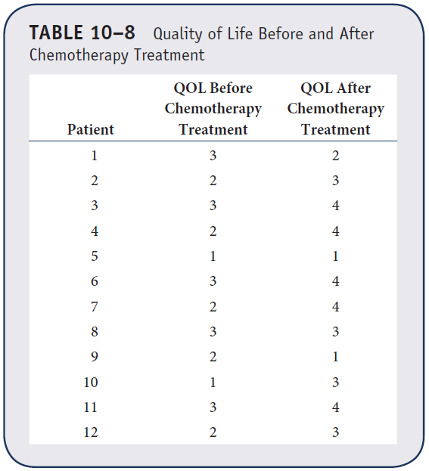
Example 10.5. Sign Test (2 of 5)
Observed data

Slide 18
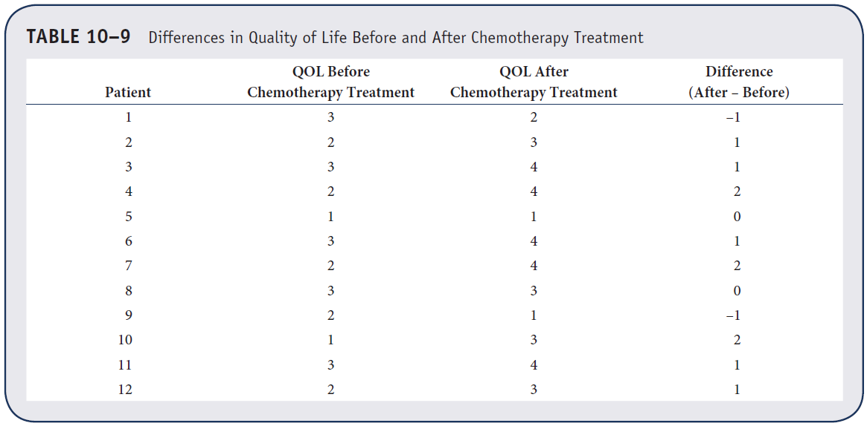
Example 10.5. Sign Test (3 of 5)
Difference scores

Slide 19
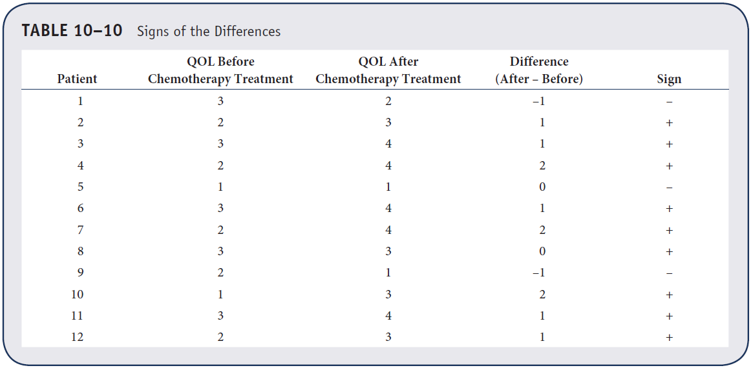
Example 10.5. Sign Test (4 of 5)
Signs of the difference scores
NOTE: Randomly assign “+” or “–” when there are zeros.

Slide 20
Example 10.5. Sign Test (5 of 5)
Test statistic is 3.
Reject H₀ if the smaller of the number of positive or negative signs ≤ 2 (Table 6).
Do not reject H₀ because 3 > 2. We do not have significant evidence to show that there is a difference in QOL measured before versus after chemotherapy treatment.

Slide 21
Tests with Matched Samples: Wilcoxon Signed Rank Test (1 of 2)
Continuous outcome measured in matched or paired samples, differences are not assumed to follow a normal distribution.
Matched or paired samples
H₀: Median difference is zero
H₁: Median difference >, <, or ≠ 0

Slide 22
Tests with Matched Samples: Wilcoxon Signed Rank Test (2 of 2)
Test statistic is W, the smaller of W+ and W–, the sums of the positive and negative ranks of the differences scores.
Reject H₀ if W ≤ critical value in Table 7.

Slide 23
Example 10.7. Wilcoxon Signed Rank Test (1 of 6)
A study is run to evaluate the effectiveness of a new exercise program to reduce systolic blood pressure (SBP) in patients with pre-hypertension; n = 15 patients participate and have SBP measured before and after 6 weeks on the program.
Is there a significant difference in SBP after participating in the program?

Slide 24
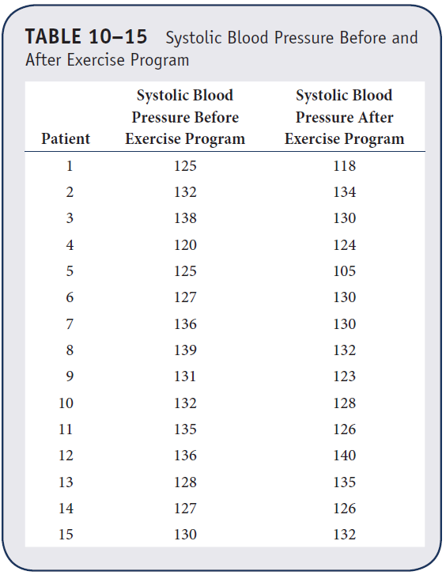
Example 10.7. Wilcoxon Signed Rank Test (2 of 6)
Observed data

Slide 25
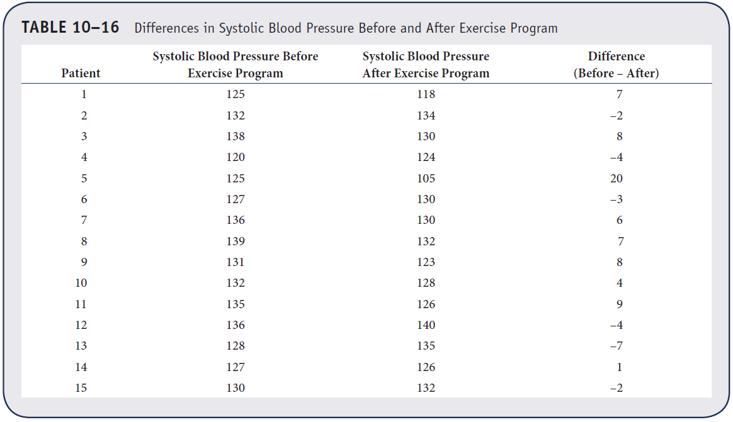
Example 10.7. Wilcoxon Signed Rank Test (3 of 6)
Difference scores

Slide 26
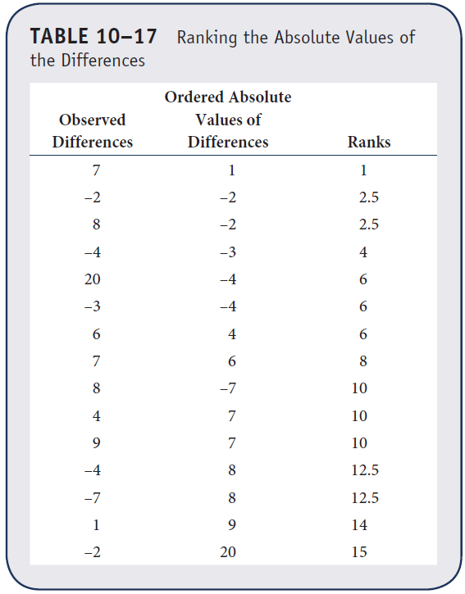
Example 10.7. Wilcoxon Signed Rank Test (4 of 6)
Ranks of the difference scores

Slide 27
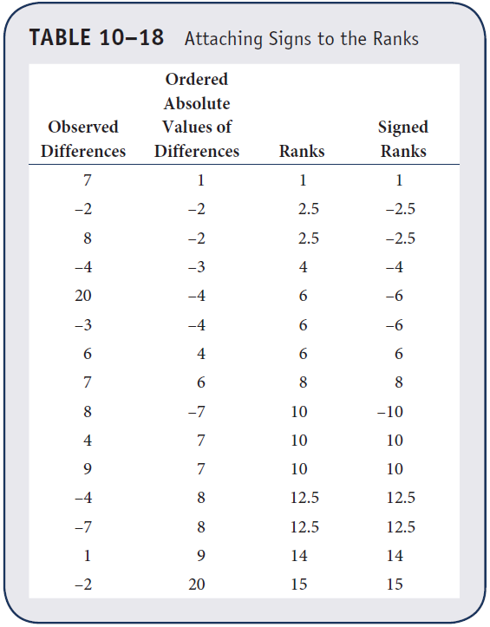
Example 10.7. Wilcoxon Signed Rank Test (5 of 6)
Signed ranks of the difference scores
W+ = 89
W– = 31

Slide 28
Example 10.7. Wilcoxon Signed Rank Test (6 of 6)
Test statistic is W = 31.
Reject H₀ if W ≤ 25 (Table 7).
Do not reject H₀ because 31 > 25. We do not have significant evidence to show that the median difference in SBP is not zero.

Slide 29
Tests with More Than Two Independent Samples: Kruskal–Wallis Test (1 of 2)
Continuous outcome that is not assumed to follow a normal distribution
k (k > 2) independent samples
H₀: k population medians are equal
H₁: k population medians are not all equal

Slide 30
Tests with More Than Two Independent Samples: Kruskal–Wallis Test (2 of 2)
Test statistic is H,
where k = number of groups, N = total sample size, nj = sample size in jth group, Rj = sum of the ranks in jth group.
Reject H₀ if H ≥ critical value in Table 8.

Slide 31
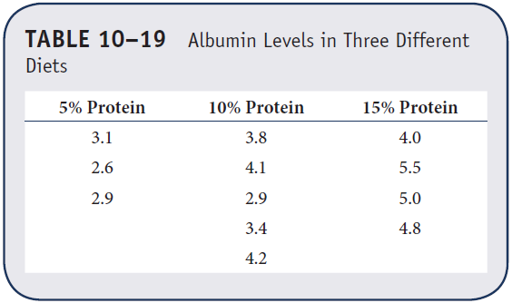
Example 10.8. Kruskal–Wallis Test (1 of 4)
A clinical study is run to assess differences in albumin levels in patients following 5%, 10%, and 15% protein diets.

Slide 32
Example 10.8. Kruskal–Wallis Test (2 of 4)
H₀: The three population medians are equal
H₁: The three population medians are not equal
α = 0.05
Test statistic is H.
Rank data in pooled sample (n = 12), and compute R₁, R₂, and R₃.

Slide 33
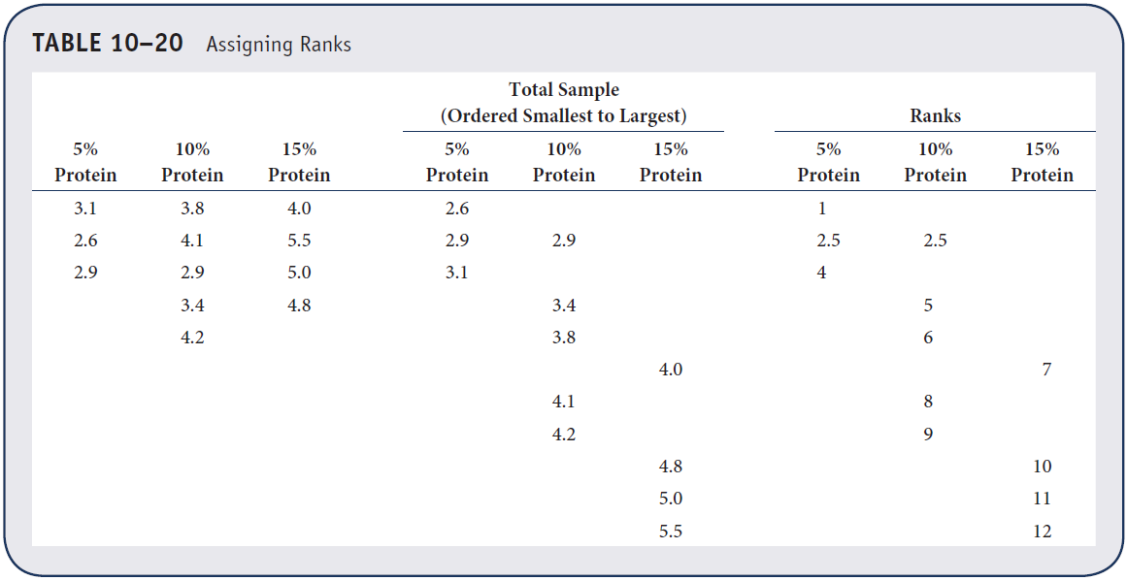
Example 10.8. Kruskal–Wallis Test (3 of 4)

Slide 34
Example 10.8. Kruskal–Wallis Test (4 of 4)
R₁ = 7.5, R₂ = 30.5, R₃ = 40.
Test statistic is H.
Reject H₀ if H ≥ 5.656 (Table 8).

Slide 35
Tests with More Than Two Independent Samples: Kruskal Wallis Test
Reject H₀ because 7.52 > 5.656.
We have statistically significant evidence to show that there is a difference in median albumin levels among the three diets.

